Slide 1
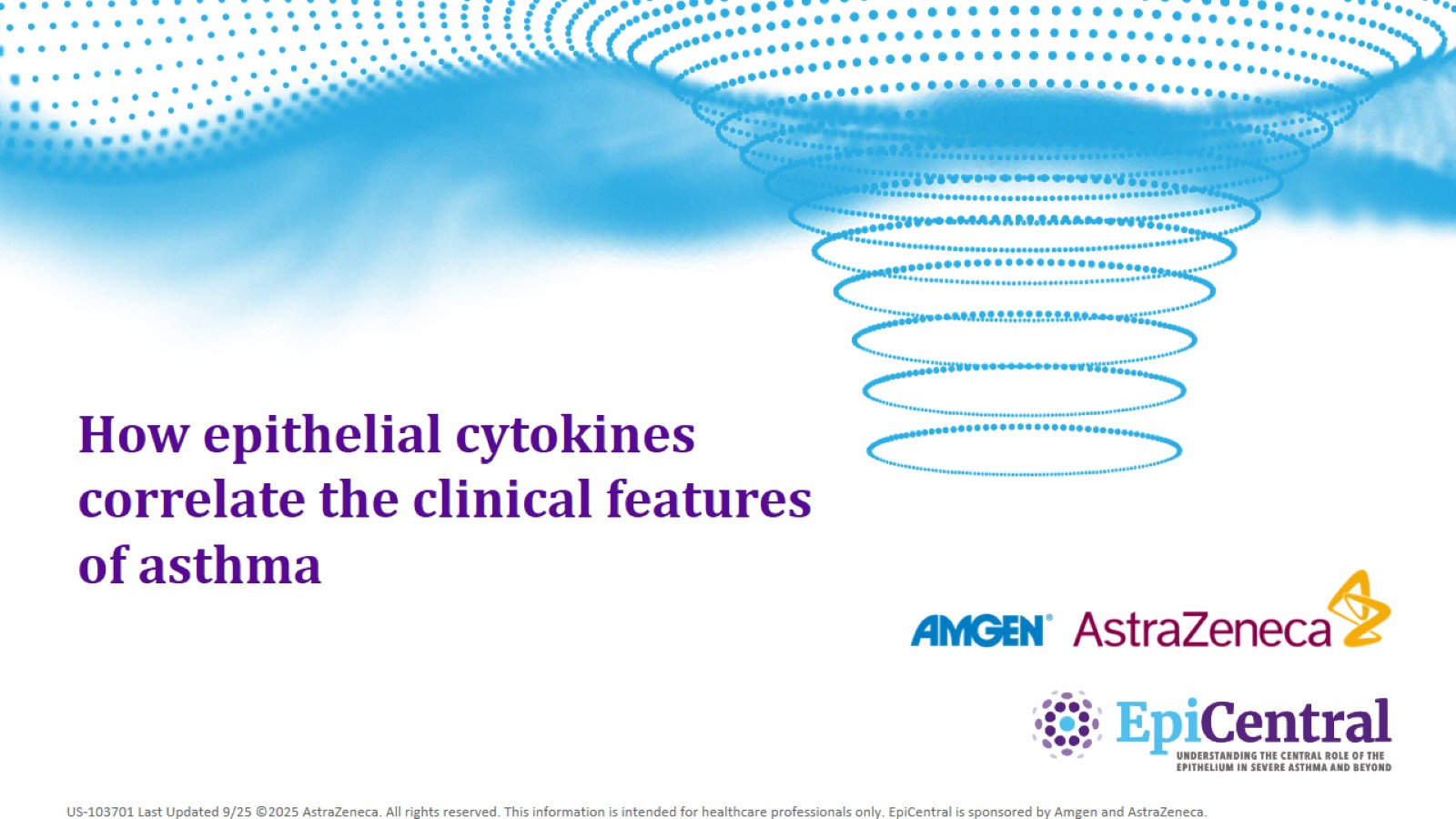
How epithelial cytokines correlate the clinical features of asthma

Slide 2
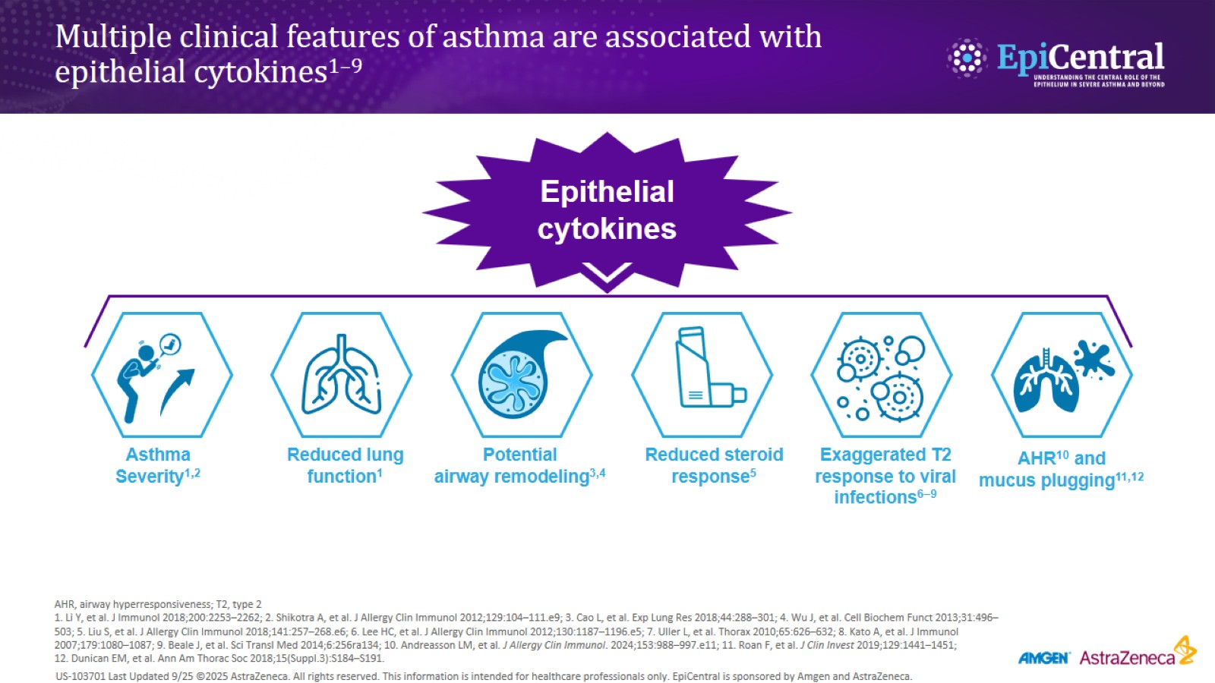
Multiple clinical features of asthma are associated with epithelial cytokines^{1–9}

Slide 3
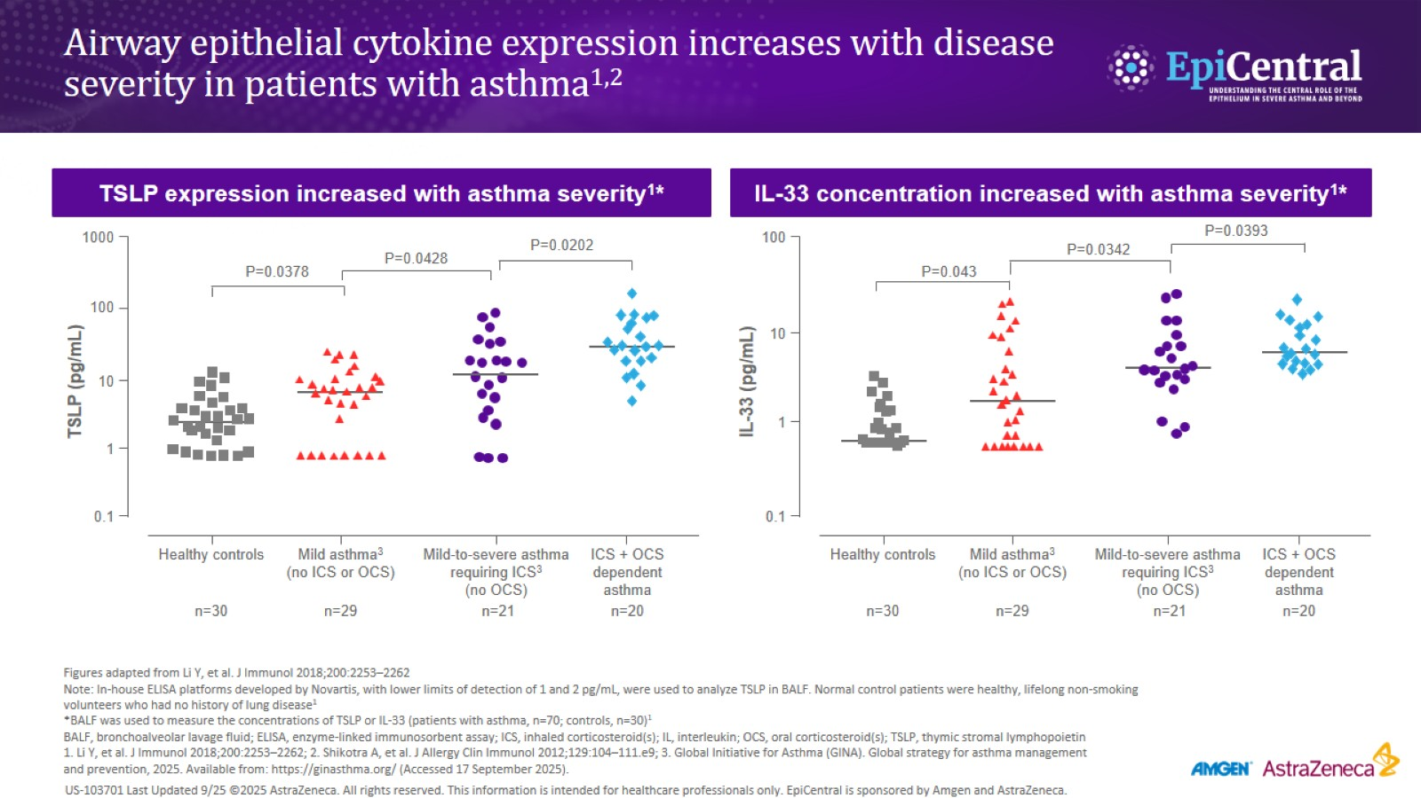
Airway epithelial cytokine expression increases with disease severity in patients with asthma^{1,2}

Slide 4
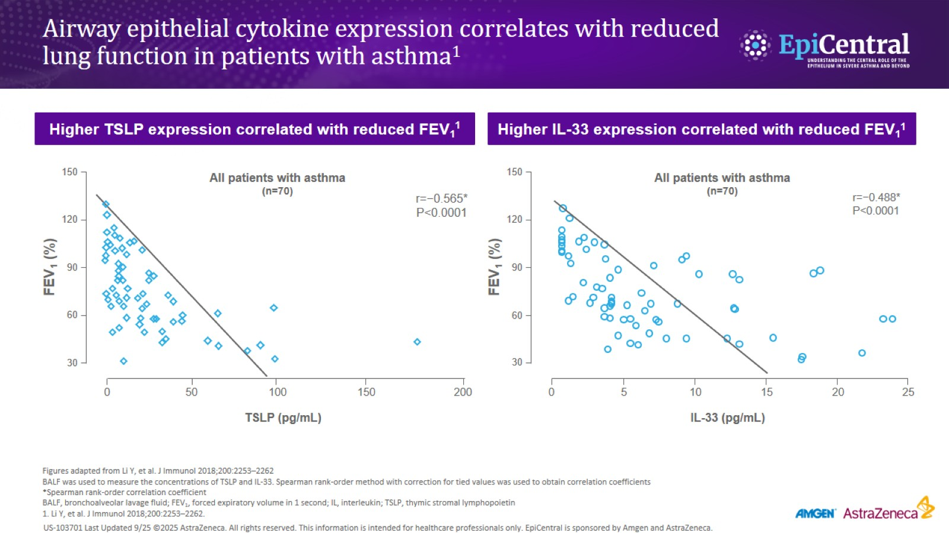
Airway epithelial cytokine expression correlates with reduced lung function in patients with asthma¹

Slide 5
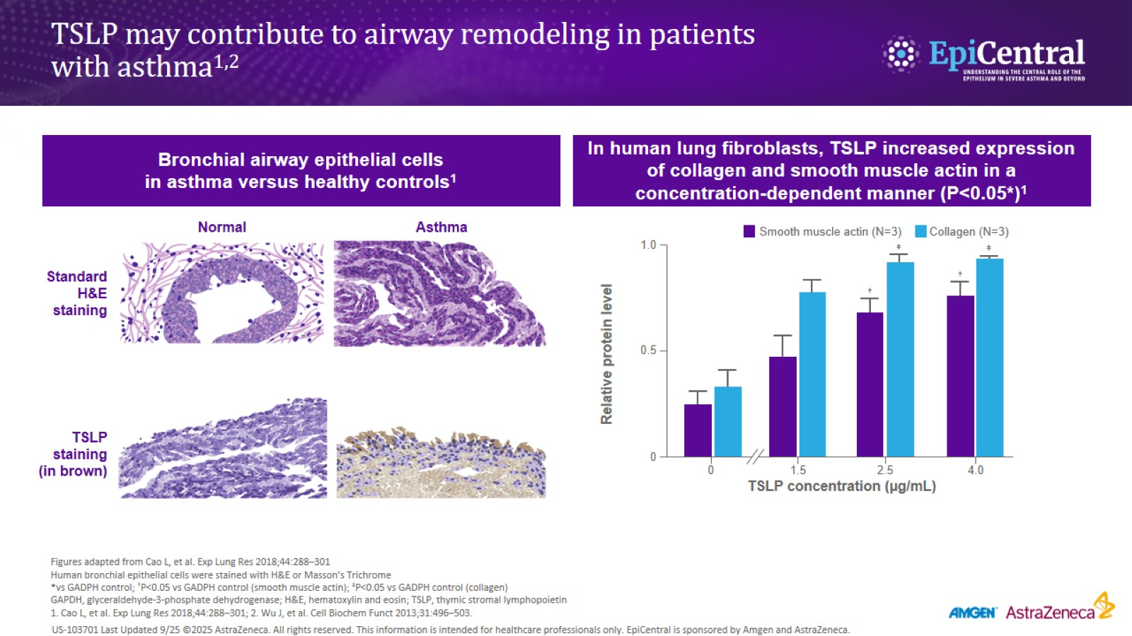
TSLP may contribute to airway remodeling in patients with asthma^{1,2}

Slide 6
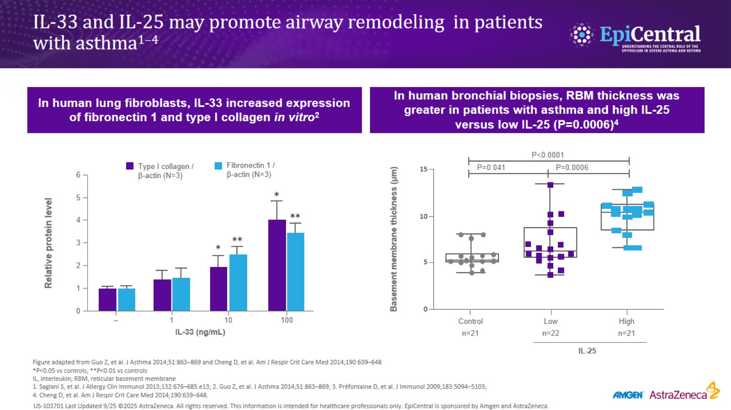
IL-33 and IL-25 may promote airway remodeling in patients with asthma^{1–4}

Slide 7
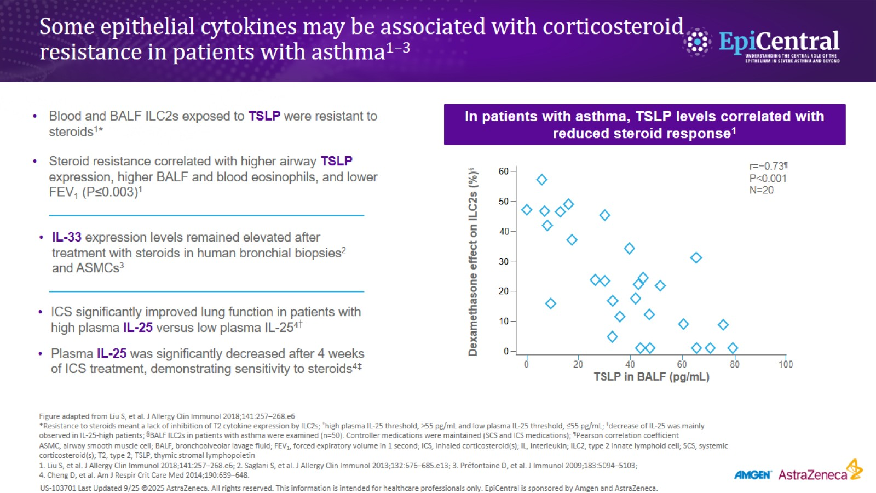
Some epithelial cytokines may be associated with corticosteroid resistance in patients with asthma^{1–3}

Slide 8
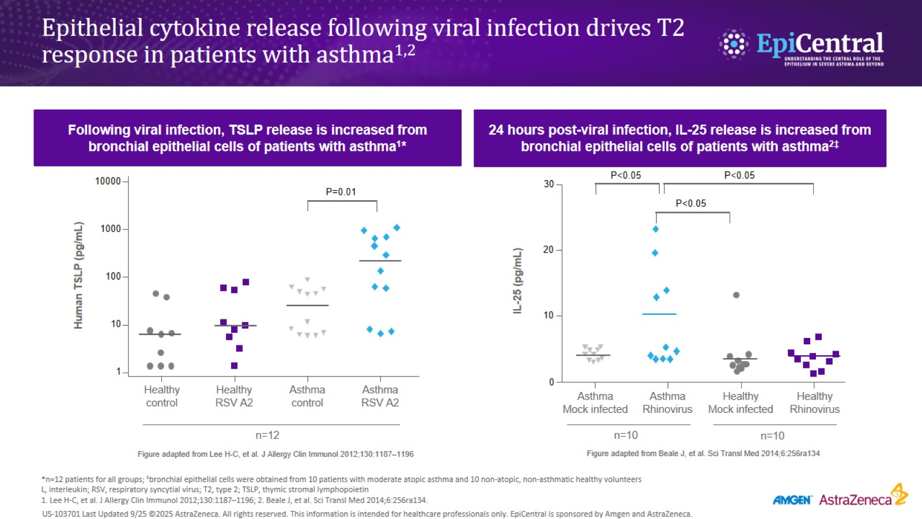
Epithelial cytokine release following viral infection drives T2 response in patients with asthma^{1,2}

Slide 9
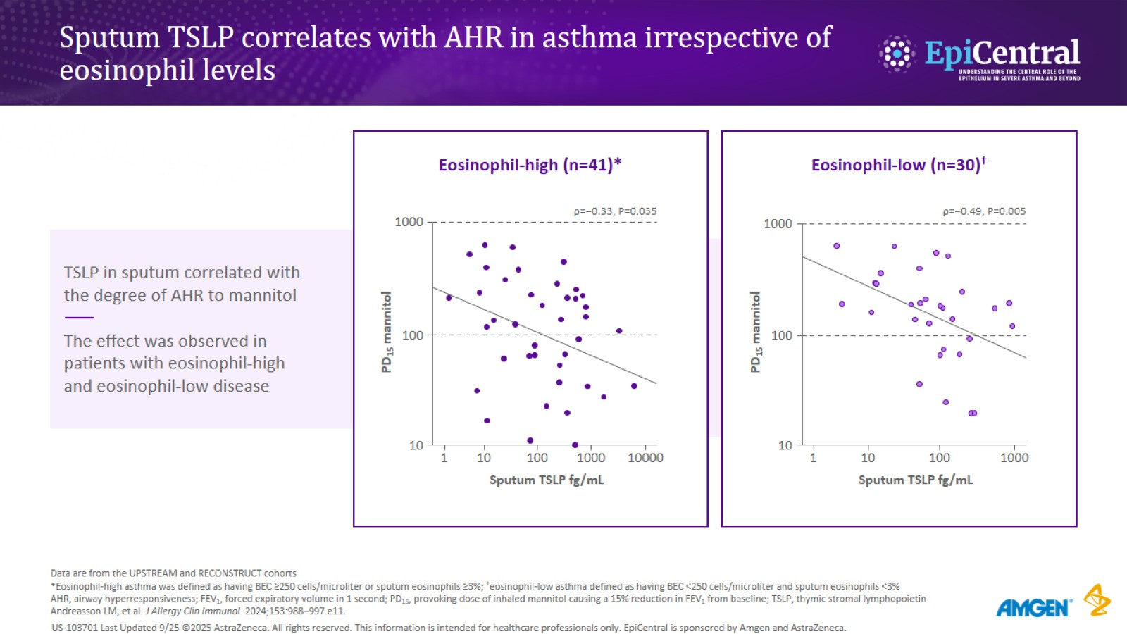

Slide 10
